Slide 1

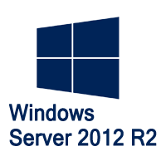
MegaSeries
Introduction to BranchCache

Slide 2
Intro
BranchCache first came about on Windows Server 2008R2 but saw some improvements on Windows Server 2012
It has not seen any notable changes in 2012 R2
It is a WAN bandwidth optimization feature especially meant for branch offices or smaller locations
Easy to set up with Group Policy and Powershell
Can be used for web servers and for file servers

Slide 3
BranchCache modes
Distributed mode : clients that are located in the branch office serve the requested files to other clients in the office. Since client computers can connect to the central file server and get data and then serve that data to other clients no server is required in the branch office
Hosted mode : a server is placed in the branch office. Clients that want to download files from the central server will ask the cache server first. If it does not have that file, the client gets it from the central server and the cache server downloads the file from the computer

Slide 4
Misc details
A minimum latency can be configured so that BC is not used for links with low latency (default is 80ms)
BC is not used for files smaller than 64KB
Active Directory Sites with subnets need to be set up in order for BranchCache to work

Slide 5
https://www.youtube.com/channel/UCcZ-jLbPwNr8E_v9-65n8Iw https://github.com/itknowledge4

